Slide 1
TIME MANAGEMENT
Career Center
www.utrgv.edu | careercenter@utrgv.edu

Slide 2
What is Time Management?
Time management is the process of planning the best way to organize the things that you need and want to do so that you can accomplish them all. Effective time management is a skill that is learned and, if used regularly, can be improved on.
Time management is important, because in order to be successful, you must balance your time wisely among many commitments, such as classes, study time, family, friends, and your jobs.

Slide 3
Time Management Assessment
I tend to be on time for classes and appointments.
I set aside time to study for exams.
I set aside time to study or read my textbook even if I do not have an exam to prepare for.
I regularly take part in social activities despite the fact that I have studying to do.
I usually cram for exams.
I usually feel prepared on the day of exams.
With everything I have to do, I find it hard to complete assignments and projects on time.
I do not experience “burn out” anytime between midterm and final exams.
I write down the things that I need to do.
I have enough time to get done what I need to, but I still find it hard to finish everything.
I hardly ever feel pressured to get things done.
Dealing with extenuating circumstances such as sorting out financial aid, getting tutoring, or seeing a professor during office hours seriously disrupts my daily or weekly routine.

Slide 4
Time Management Assessment
Answer Key
For statements: 1, 2, 3, 6, 8, 9, 11
    Give yourself 1 point for each statement when you said you agree
For statements: 4, 5, 7, 10, 12
    Give yourself 1 point for each statement when you said you disagree

Slide 5
Where Does Your Time Management Clock In?
If you scored between 9 and 12, congratulations! You are a good time manager.
If you scored between 5 and 8, you are doing some things right.
If you scored between 1 and 4, you need to spend extra time working on your skills.
Regardless of your score, the tips on the following slides can help you improve your time management skills!

Slide 6
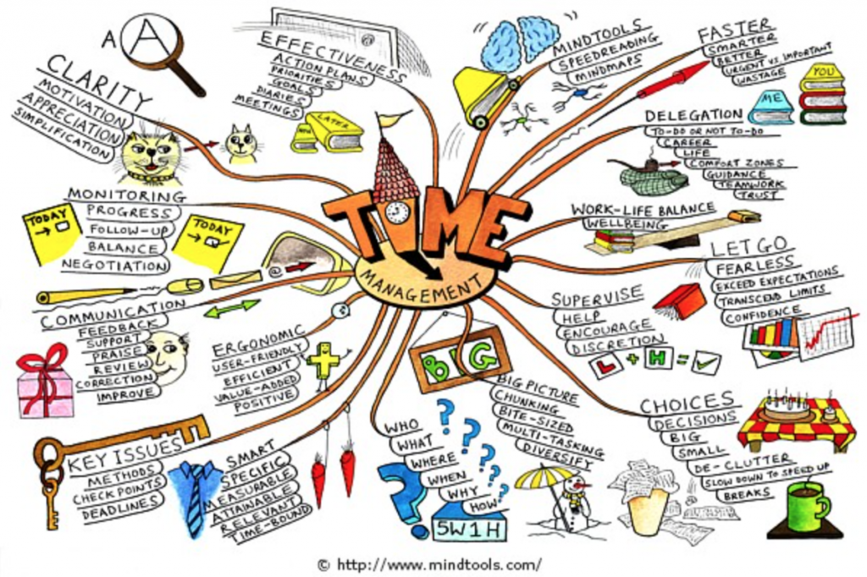

Slide 7
Myths about Time Management
Time management is nothing but common sense. I d never had problems as a undergrad, so I must be managing my time effectively.
It takes all the fun out of life!!!
Time management? I work better under pressure.
No matter what I do, I won’t have enough time!

Slide 8
What You Can Do To Enhance Your Time Management Skills?
Be conscious of the amount of time you spend on academic, social, and personal activities and at work.
The goal of time management is to find a balance among all the things you need and want to do.
One of the best ways for college students to manage their time is with a planned weekly schedule.

Slide 9
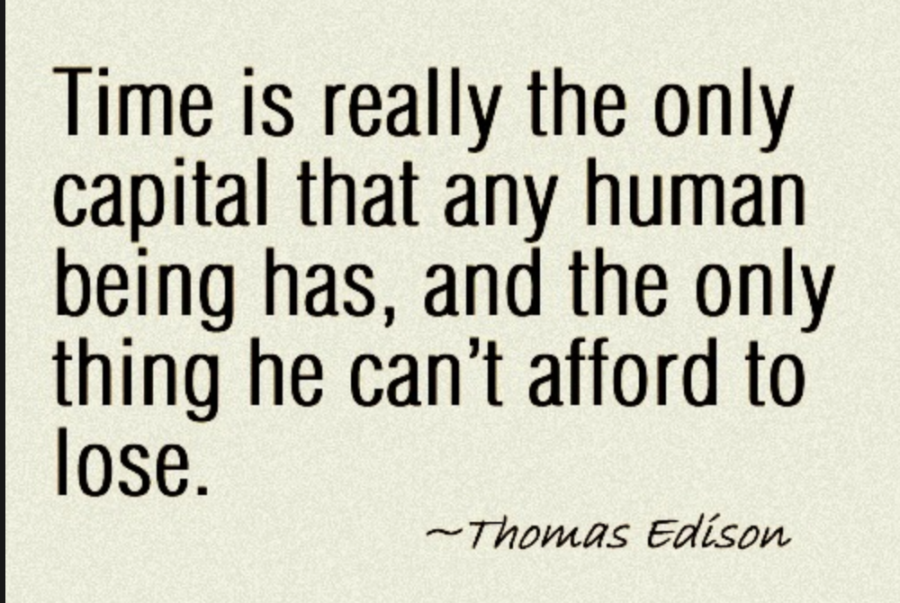

Slide 10
Consequences
By some estimates, people waste about 2 hours per day.
  Signs of time wasting:
    Messy desk and cluttered (or no) files
    Can’t find things
    Miss appointments, need to reschedule them late and/or unprepared for meetings
    Volunteer to do things other people should do
    Tired/unable to concentrate

Slide 11
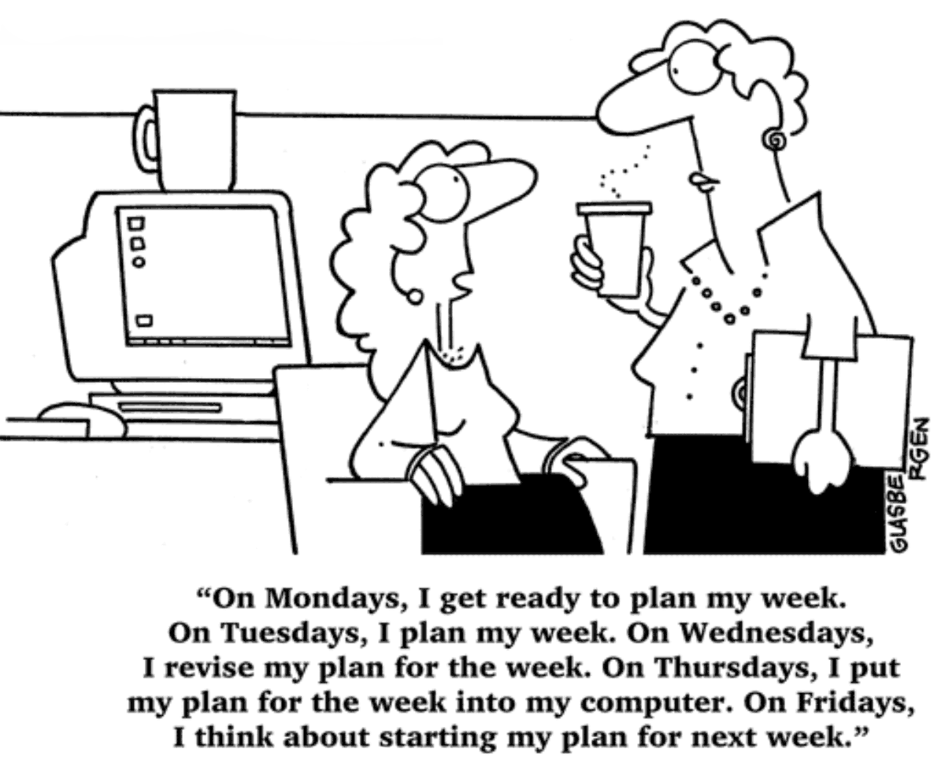

Slide 12
For starters
Why am I doing this?
What is the goal?
Why will I succeed?
What happens if I chose not to do it?

Slide 13
Keeping Time
Focus on clarifying goals and rewarding
accomplishments
PRIORITIZE
Balance multiple responsibilities to self and others
Schedule and Complete Tasks
Cope with Perfectionism
Avoid Obstacles to Success

Slide 14
Planned Weekly Schedules
It is recommended to use a weekly schedule that coincides with your average weekly work/class schedule.
Have a monthly schedule as well to allow you to plan ahead for tests, personal activities and projects that are weeks away.

Slide 15
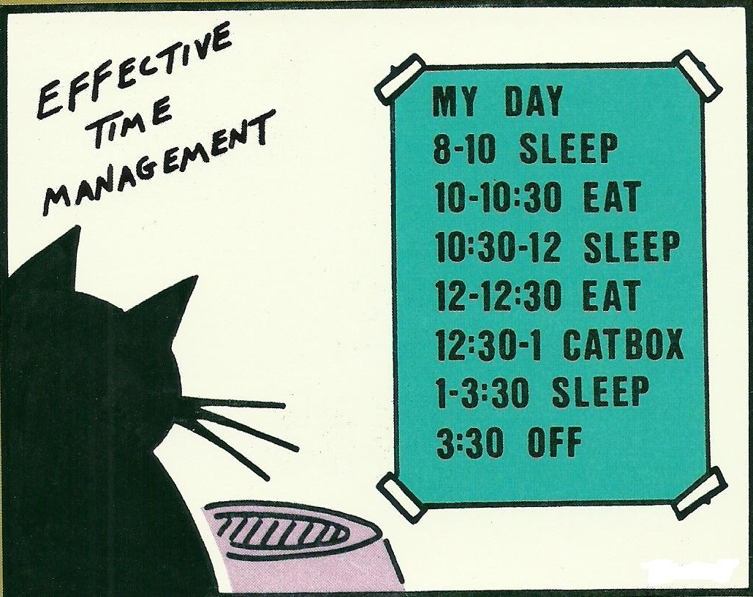

Slide 16
General Tips when using a Planned Weekly Schedule
Schedule fixed commitments such as classes, employment, and appointments first
Schedule a balance of academic, social, and personal time in addition to your work time. Remember that relaxation is needed for balance
Beware of little things that use precious time, such as walking to class, waiting in line for lunch, and checking email and plan for these items in your schedule
If possible, tasks that take up a large amount of time should be organized into and completed by smaller, more manageable blocks of time (i.e., studying 8 hours for one comprehensive final can be broken down into 2-hour study blocks over four nights)
Allow some flexibility in your schedule so that you can accommodate any unexpected circumstances that come up
Schedule at least 30 minutes a week to update or rearrange your schedule for the next week as needed

Slide 17
Start Early and Work Steadily
Start Early: The earlier you begin a task, the sooner it will be finished and the more time you will have to handle problems that may arise.
Work Steadily: Doing a little at a time instead of doing everything in one marathon session is less stressful, helps you absorb more of the material when you are studying, and usually results in better work on projects and papers.

Slide 18
Break Large Tasks Down
Smaller tasks are easier to understand and manage than large tasks. You also get the feeling of accomplishing more when you can completely finish several smaller tasks rather than finishing half of a single large task.
Smaller tasks are also easier to fit into your schedule. It is easier to find five one-hour blocks of time in your week than one five-hour block.
Research is a good example. By dividing your workload into several phases the large, daunting project becomes four smaller tasks, each of which is less stressful and easier to handle.
  Be realistic

Slide 19
Write Down What You Need To Do
Writing things down on paper prevents you from forgetting them.
It is harder to put off or ignore what you have written down concretely on paper.
A task list is a time management tool. It shows you everything you need to do in the immediate future so you can plan your time accordingly.
A formal task list on paper used in conjunction with a planned weekly schedule gives you a single tool to track everything you want or need to do.

Slide 20
Prioritize Your Tasks
When you have a written list of what you need to do, you can add a priority (high, medium, or low) to each task telling you how important that task is.
The priority should be based on:
    When the item must be completed (items due soon are higher priority)
    What other items depend on this item (if three items cannot be started until this one is completed, it is of a higher priority)
    How much time the item will take (items taking longer to complete are higher priority)
When you do the high priority items first, you take the pressure off yourself.

Slide 21
Learn to say “No”
Will this help me get my masters?
Will this help me get my PhD?
Keep “help me” broadly defined

Slide 22
Delegate Things
Grant authority with responsibility
Concrete goal, deadline, and consequences
Treat people well
Undergraduates and other staff can be your lifeline if you give them the chance

Slide 23
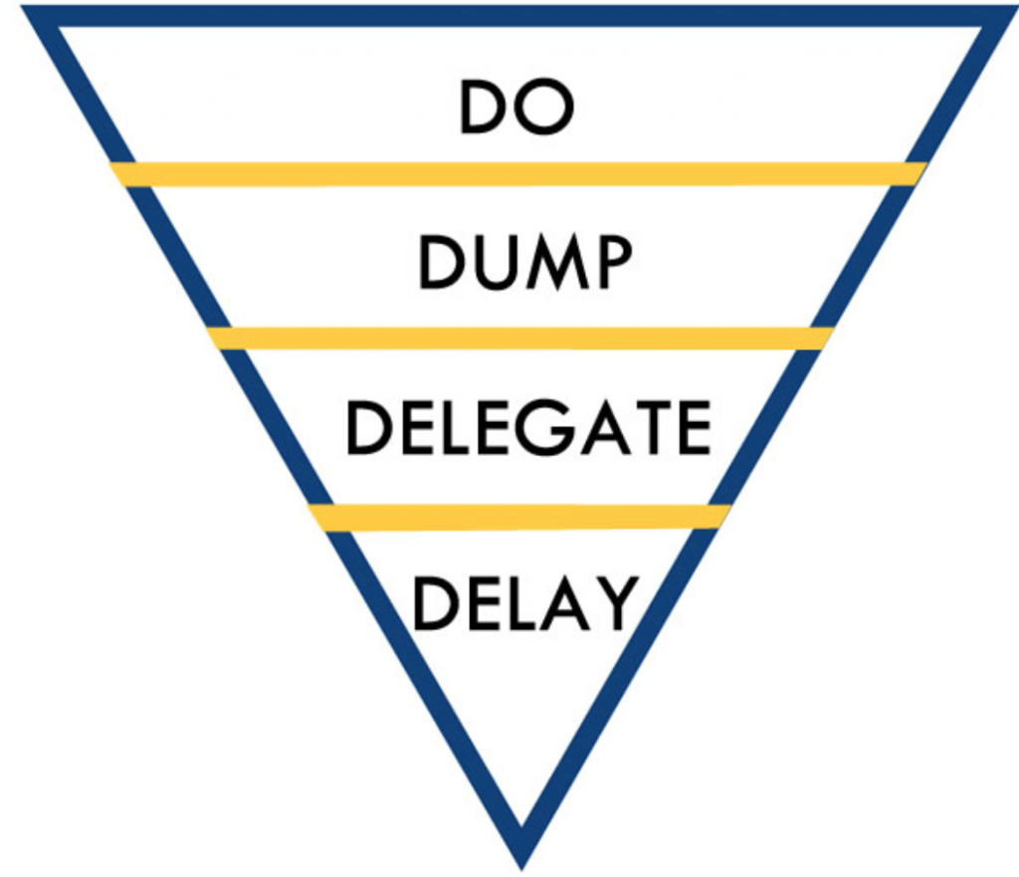

Slide 24
Summary
Remember, time management is a skill. You have to use it to learn it and to get better at it.
Use a weekly schedule to organize your time.
    AND stick to it
Write down what you need to do in a task list, prioritize it, delegate and start immediately!

