Slide 1
UTRGV
2020 National Survey of Student Engagement (NSSE)
Survey Highlights
Prepared by:
Office of Strategic Analysis and Institutional Reporting (SAIR)
August 2020

Slide 2

Outline
What is NSSE?
Response Rate at UTRGV
Four NSSE Themes for Student Engagement
Engagement Indicators in NSSE Themes
Performance Comparisons
Satisfaction with UTRGV
First-year students’ performance
Senior students’ performance
Recommendations

Slide 3
What is NSSE?
The National Survey of Student Engagement (NSSE) collects information from first-year and senior students about the characteristics and quality of their undergraduate experience. It assesses the extent to which students engage in educational practices associated with high levels of learning and development.
The results provide an estimate of how undergraduates spend their time and what they gain from attending their college or university.
Institutions use their data to identify aspects of the undergraduate experience that can be improved through changes in policy and practice.

Slide 4
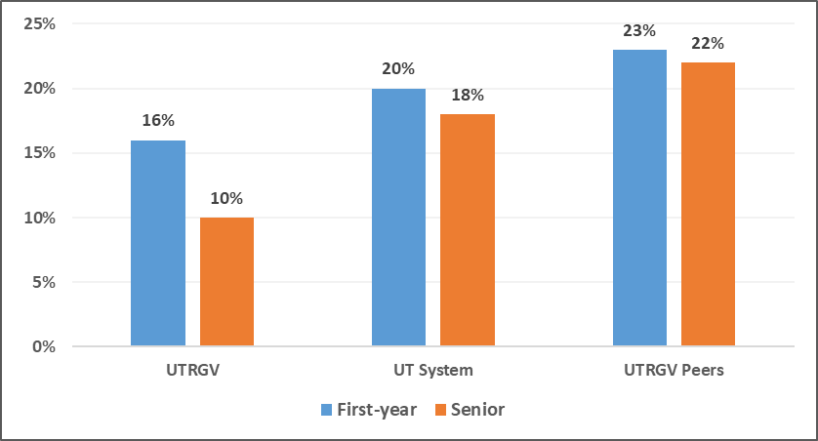
Response Rate
Note:
UT System includes the following participants - UT Arlington, UTD, UTEP, UTSA, UT Tyler, and UT Permian Basin.
UTRGV Peers includes 6 Peer institutions that participated in NSSE 2020. They are New Mexico State University, University of Memphis, University of Missouri-Kansas City, UT El Paso, and UT San Antonio.
Notes:
Note:
UT System includes the following participants - UT Arlington, UTD, UTEP, UTSA, UT Tyler, and UT Permian Basin.
UTRGV Peers includes 6 Peer institutions that participated in NSSE 2020. They are New Mexico State University, University of Memphis, University of Missouri-Kansas City, UT El Paso and, UT San Antonio.

Slide 5
Four NSSE Themes for Student Engagement
Academic Challenge
Challenging intellectual and creative work is central to student learning and collegiate quality. Colleges and universities promote student learning by challenging and supporting them to engage in various forms of deep learning. Four Engagement Indicators are part of this theme: Higher-Order Learning, Reflective & Integrative Learning, Learning Strategies, and Quantitative Reasoning.
Experiences with Faculty
Students learn firsthand how experts think about and solve problems by interacting with faculty members inside and outside of instructional settings. As a result, faculty become role models, mentors, and guides for lifelong learning. In addition, effective teaching requires that faculty deliver course material and provide feedback in student-centered ways. Two Engagement Indicators investigate this theme: Student-Faculty Interaction and Effective Teaching Practices.
Learning with Peers
Collaborating with others in mastering difficult material and developing interpersonal and social competence prepare students to deal with complex, unscripted problems they will encounter during and after college. Two Engagement Indicators make up this theme: Collaborative Learning and Discussions with Diverse Others.
Campus Environment
Students benefit and are more satisfied in supportive settings that cultivate positive relationships among students, faculty, and staff. Two Engagement Indicators investigate this theme: Quality of Interactions and Supportive Environment.
Notes:
NSSE has 4 themes for student engagement. They are: Academic Challenge, Experiences with Faculty, Learning with Peers, and Campus Environment.

Slide 6
Engagement Indicators in NSSE Themes
Academic Challenge
Learning with Peers
Experiences with Faculty
Campus Environment
Higher-Order Learning
Collaborative Learning
Student-Faculty Interaction
Quality of Interactions
Reflective & Integrative Learning
Learning Strategies
Discussions with Diverse Others
Effective Teaching Practices
Supportive Environment
Quantitative Reasoning
Notes:
Each of the 4 themes has engagement indicators. The indicators are ….. (see table above).

Slide 7
Performance Comparisons for UTRGV on
Academic Challenge
 | First-Year Students |  |  |  | Seniors
Academic Challenge | UTRGV Score | Compared with… |  |  | UTRGV Score | Compared with …
 |  | UT System | Carnegie Doctoral | UTRGV Peers |  | UT System | Carnegie Doctoral | UTRGV Peers
Higher-Order Learning | 38.3 |  |  |  | 41.3
Reflective & Integrative Learning | 34.6 |  |  |  | 37.5
Learning Strategies | 39.1 |  |  |  | 38.9
Quantitative Reasoning | 27.8 |  |  |  | 29.3
☺
☺
☺
☺
☺
☺
☺
☺
_{The Scale is 60 points}
indicates the score of UTRGV is significantly lower than this comparison group
indicates the score of UTRGV is significantly higher than this comparison group
A BLANK indicates no statistically significant difference
☹
☺
Notes:
This is how UTRGV compares with UT System schools, Carnegie Doctoral, and UTRGV Peers on Academic Challenge. The Green Smiley face shows that we do significantly better than that category on the specific Engagement Indicator. The Red Frowning face indicate that we do significantly poorly than that category of schools on the specific Engagement Indicator. A Blank indicates no statistically significant difference. We have a few areas where we are better than our comparison groups and we also have a few areas which could use improvement.

Slide 8

Performance Comparisons for UTRGV on
Learning with Peers
 | First-Year Students |  |  |  | Seniors
Learning with Peers | UTRGV Score | Compared with… |  |  | UTRGV Score | Compared with …
 |  | UT System | Carnegie Doctoral | UTRGV Peers |  | UT System | Carnegie Doctoral | UTRGV Peers
Collaborative Learning | 33.9 |  |  |  | 35.4
Discussions with Diverse Others | 32.6 |  |  |  | 32.2
☺
☺
☺
☹
☹
☹
☹
☹
☹
_{The Scale is 60 points}
indicates the score of UTRGV is significantly lower than this comparison group
indicates the score of UTRGV is significantly higher than this comparison group
A BLANK indicates no statistically significant difference
☹
☺
Notes:
This is how UTRGV compares with UT System schools, Carnegie Doctoral, and UTRGV Peers on Learning with Peers. We have mixed results on this Theme. Collaborative Learning is good, but diversity is lacking due to the homogeneous makeup of our student body.

Slide 9
Performance Comparisons for UTRGV on
Experiences with Faculty
 | First-Year Students |  |  |  | Seniors
Experiences with Faculty | UTRGV Score | Compared with… |  |  | UTRGV Score | Compared with …
 |  | UT System | Carnegie Doctoral | UTRGV Peers |  | UT System | Carnegie Doctoral | UTRGV Peers
Student-Faculty Interaction | 23.1 |  |  |  | 24.5
Effective Teaching Practices | 41.0 |  |  |  | 41.1
☺
☺
☺
☺
☺
☺
☺
☺
☺
☺
☺
_{The Scale is 60 points}
indicates the score of UTRGV is significantly lower than this comparison group
indicates the score of UTRGV is significantly higher than this comparison group
A BLANK indicates no statistically significant difference
☹
☺
Notes:
This is how UTRGV compares with UT System schools, Carnegie Doctoral, and UTRGV Peers on Experiences with Faculty. This chart is a good indication of the faculty we have at UTRGV. They need to be applauded for their hard work.

Slide 10
Performance Comparisons for UTRGV on
Campus Environment
 | First-Year Students |  |  |  | Seniors
Campus Environment | UTRGV Score | Compared with… |  |  | UTRGV Score | Compared with …
 |  | UT System | Carnegie Doctoral | UTRGV Peers |  | UT System | Carnegie Doctoral | UTRGV Peers
Quality of Interactions | 44.6 |  |  |  | 43.2
Supportive Environment | 37.3 |  |  |  | 34.3
☺
☺
☺
☺
☺
☺
☺
☺
☺
☺
_{The Scale is 60 points}
indicates the score of UTRGV is significantly lower than this comparison group
indicates the score of UTRGV is significantly higher than this comparison group
A BLANK indicates no statistically significant difference
☹
☺
Notes:
This is how UTRGV compares with UT System schools, Carnegie Doctoral, and UTRGV Peers on Campus Environment. We have significantly improved with our first-year students and seniors on campus environment.

Slide 11
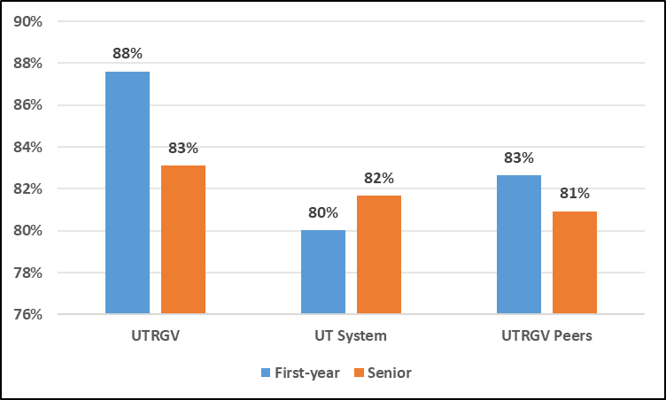
Satisfaction with UTRGV
Percentage of Students Rating Their Overall Experience at their institution as "Excellent" or "Good"
Notes:
Students rated their overall experience at the institution, and whether or not they would choose
it again.

Slide 12
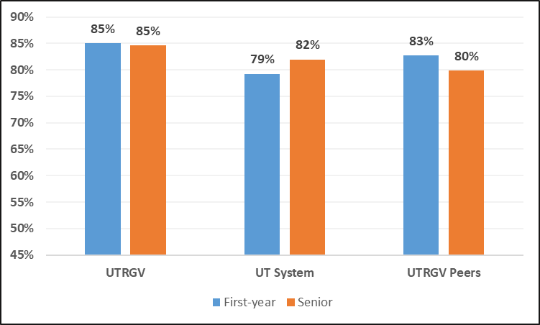
Satisfaction with UTRGV
Percentage of Students who would “Definitely” or “Probably” Attend this Institution Again

Slide 13
First-Year Students had significantly higher scores on the following as compared to Comparison Institution Groups
Faculty:
Clearly explaining course goals & requirements
Teaching course sessions in an organized way
Using examples or illustrations to explain difficult points
Providing feedback on a draft or work in progress
Providing prompt and detailed feedback on tests or completed assignments
Students:
Reviewing notes after class
Working with other students on course projects or assignments
Talking about career plans with a faculty member
Discussing academic performance with a faculty member
Institution contributes by:
Providing experience to writing clearly and effectively
Including community-based (service-learning) projects in some courses
Thinking critically and analytically
Providing the experience to speak clearly and effectively
Providing the experience to work effectively with others
Providing the experience to develop/clarify a personal code of values & ethics
Being an informed and active citizen

Slide 14
First-Year Students had significantly lower scores on the following as compared to Comparison Institution Groups
Students:
Having interactions and discussions with diverse groups
Preparing for class (studying, reading, writing, doing homework or lab work, analyzing data, rehearing, and other academic activities).
Participating in a learning community or some other formal program where groups of students take two to more classes together
Number of hours spent on preparing for class
Participating in co-curricular activities (organizations, campus publications, etc.)

Slide 15
Senior Students had significantly higher scores on the following as compared to Comparison Institution Groups
Faculty:
  Providing feedback on a draft or work in progress
  Providing prompt and detailed feedback on tests or competed assignments
Students:
Preparing for exams by discussing or working through course material with other students
Working with other students on course projects or assignments
Participating in community service or volunteer work
Interacting with Students
Interacting with Faculty
Institution contributes by:
Including community-based (service-learning) projects in some courses
Providing the experience to develop/clarify a personal code of values & ethics
Helping manage non-academic responsibilities (work, family, etc.)
Student feeling like part of the community at this institution

Slide 16
Senior Students had significantly lower scores on the following as compared to Comparison Institution Groups
Students:
Having interactions and discussions with diverse groups

Slide 17
For detailed frequency tables and more information on NSSE Results
Visit
http://www.utrgv.edu/sair
(Look under “Data and Reports” for Student Survey Results)

